Slide 1
Architecture Patterns

Slide 2
Architecture Observation
Many systems have a similar solution structure
  What is common among these solutions?
  What variations can be distinguished?
  When should we use a particular approach?
  How should we apply and customize a particular approach?

Slide 3
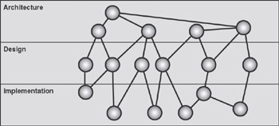
Architecture, Design and Implementation

Slide 4
Architecture Patterns
An architectural pattern is a proven structural organization schema for software systems
  A set of predefined subsystems and their responsibilities
  Rules and guidelines for organizing the relationships between them
  Example: Model-View-Controller

Slide 5
Pattern characteristics
A pattern addresses a recurring design problem
A pattern documents existing, well-proven design experience
Patterns provide a common vocabulary and understanding for design principles
Patterns are a means of documenting software architectures
Patterns support the construction of software with defined properties

Slide 6
Pattern schema
Context: a situation giving rise to a problem
Problem: the recurring problem arising in that context
  Requirements the solution must fulfill
  Constraints to be considered
  Desirable properties the solution should have
Solution: proven resolution of the problem
  Structure with components and relationships
  Run-time behavior ( dynamic)

Slide 7
Design patterns vs. architecture patterns
design pattern provides a scheme for refining the subsystems or components
  Examples: Observer, Strategy, Abstract Factory, Proxy …
Design patterns are smaller in scale than architectural patterns
  Do not influence the fundamental structure of a software system
  Only affect a single subsystem
  Help in implementing architectural patterns

Slide 8

Pattern:Layers

Slide 9
Pattern: Layers
The Layers architectural pattern helps to structure applications that can be decomposed into groups of subtasks in which each group of subtasks is at a particular level of abstraction
  Each layer provides services to the (next) higher layer
  Services in a layer are implemented by using services from the (next) lower layer
  Service requests frequently done by using synchronous procedure calls

Slide 10
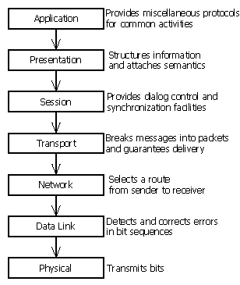
Pattern:Layers
Example: networking protocols
  ISO Open Systems Interconnect 7-layer model
  TCP/IP

Slide 11
Pattern: Layers
Example: virtual machines
  e.g. JVM
Example: APIs
  e.g. C standard library, built on Unix system calls
Example: information systems
  e.g. client/server, presentation/business/domain/data
Example: operating systems
  e.g. microkernel architecture (Windows NT, 2000, XP, …)

Slide 12
Pattern: Layers
Most stable abstractions on the lowest layer
Changes/additions may be localized to a particular layer
Layer services can be implemented in different ways
  cf. Bridge design pattern: maintains dynamic link between abstraction and implementation
Layers can be developed independently
Defining abstract service interfaces is not easy
Performance overhead due to repeated transformations of data
Lower layers may perform unnecessary work not required by the higher layer

Slide 13
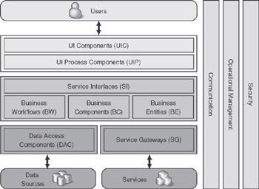
Three-Layered Enterprise Application

Slide 14
Three-Layered Enterprise Application
Presentation Layer
  The presentation layer provides the application’s user interface (UI). Typically, this involves the use of Windows Forms for smart client inter-action, and ASP.NET technologies for browser-based interaction.
Business Layer
  The business layer implements the business functionality of the application. The domain layer is typically composed of a number of components implemented using one or more .NET – enabled programming languages.
Data Layer
  The data layer provides access to external systems such as databases.

Slide 15
Pattern: Model-View-Controller

Slide 16
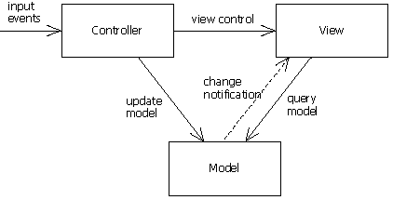
Pattern: Model-View-Controller
Divides an interactive application into three components
Model: core functionality and data
Views: display information to the user
Controllers: handle user input

Slide 17
Pattern: Model-View-Controller
Multiple GUIs
Model independent of number and kind of GUIs
Easily changeable ‘look and feel’
Consistency via notification
  Uses Observer design pattern
Examples:
  Smalltalk
  Web presentation (see chapter on Enterprise application architecture)
  Document-View architecture of Windows applications

Slide 18
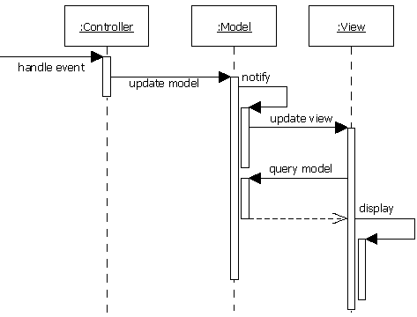
Pattern: Model-View-Controller

Slide 19
Pattern: Client-Server

Slide 20
Pattern: Client-Server
Server components provide services to multiple clients
Client components request services from server components
Requests are done over process & machine boundaries
  Using some inter-process communication mechanism
  Layered architecture crossing process or machine boundaries
Servers permanently active, listening for clients
Examples:
  Remote DB access
  Remote file systems
  Multi-tier information systems
  Web applications

Slide 21
Pattern: Client-Server
Requests typically handled in separate threads
Inter-process communication causes overhead
  Marshalling request/result data
  Network traffic
Transparency in distributed systems
  Access transparency, location transparency, platform transparency, failure transparency, …
Intermediate layers inserted for specific purposes
  Caching, security, load balancing, …
Callbacks sometimes needed
  Event notification
  Transition to peer-2-peer model

Slide 22
Pattern: Client-Server
Clients and servers are often involved in ‘sessions’
Stateless servers:
  Session state is managed by the client
  Sent with each request
  Client Session State Pattern
Stateful servers:
  Session state is managed by the server
  Associated with client-id
Considerations:
  Transactions
  Fault handling
  Scalability

Slide 23
Pattern: Master-Slave

Slide 24
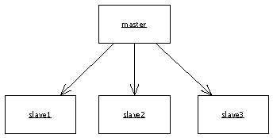
Pattern: Master-Slave
The Master-Slave pattern supports fault tolerance and parallel computation.
A master component distributes work to identical slave components and computes a final result from the results these slaves return.
Examples:
  Process control
  Embedded systems
  Large-scale parallel
  computations
  Fault tolerant systems

Slide 25
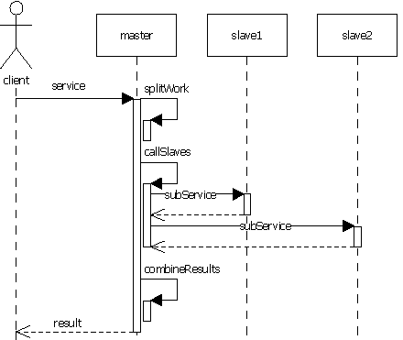
Pattern: Master-Slave

Slide 26
Pattern: Master-Slave
‘Divide and conquer’ model
  When master fails, the system fails
Coordination separated from actual work
Slaves are isolated, no shared state
Slaves can operate in parallel
Master-slave communication latency can be an issue
  e.g. in hard real-time systems
Problem must be decomposable
Application areas:
  fault tolerance
  parallel computation
  computational accuracy

Slide 27
Pattern: Pipe-Filter

Slide 28

Pattern: Pipe-Filter
Provides a structure for systems that produce a stream of data
Each processing step is encapsulated in a filter component
Data is passed through pipes between adjacent filters
  Pipes handle buffering and synchronization
Examples:
  Compilers
  Unix shell commands

Slide 29
Pattern: Pipe-Filter
New filters added easily
Filters are reusable
  Can be developed independently
  Potential data transformation overhead
Input and output can come from, go to different places
Natural concurrent processing
  Throughput and deadlock analysis uncomplicated
No shared state among filters
Not suited for interactive applications

Slide 30
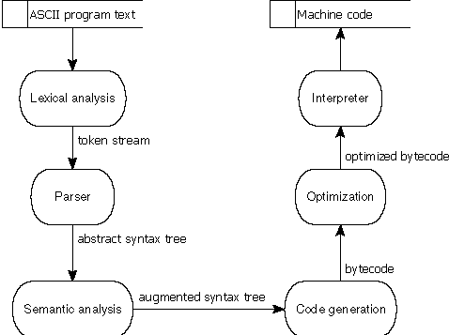
Pattern: Pipe-Filter

Slide 31
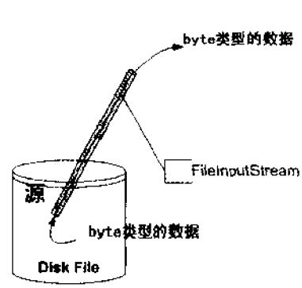
Java中的管道
InputStream in =
new BufferedInputStream (new DataInputStream(System.in))

Slide 32
Pattern: Broker

Slide 33
Pattern: Broker
Used to structure distributed software systems with decoupled components that interact by remote service invocations
A broker component is responsible for coordinating communication
  Forwarding requests, transmitting results and exceptions
Servers publish their capabilities (services + characteristics) to a broker
Clients request a service from a broker
Broker redirects requests to a suitable service from its registry

Slide 34
Pattern: Broker
Broker architecture allows dynamic change, addition, deletion, and relocation of objects
Makes distribution transparent to the developer
Requires standardization of service descriptions
Bridges are optional components used for hiding implementation details when two brokers interoperate
Examples:
  CORBA (Common Object Request Broker Architecture) for cooperation among heterogeneous object-oriented systems
  Web services

Slide 35
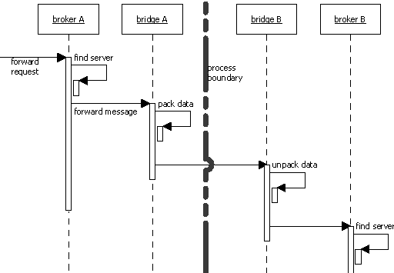
Pattern: Broker

Slide 36
Pattern: Broker
An Interface Definition Language (IDL) contains a textual description of the interfaces a server offers to its clients
  Example: CORBA IDL, Microsoft .NET CIL, WSDL
  May be implemented for any programming language
The alternative is a binary standard
  Example: Microsoft OLE
  Consists of a table containing pointers to method implementations
  Allows clients to call methods indirectly using pointers
  Needs support from the programming language

Slide 37
Web services
UDDI
  Universal Discovery, Description and Integration
  Repository with organizations that offer services
WSDL
  Web Service Description Language
  Definition of the interface of a web service
SOAP
  Simple Object Access Protocol
  Transport protocol for XML-messages
XML
  Extendible Markup Language
  Language for expressing messages

Slide 38
Pattern: Peer-2-Peer

Slide 39
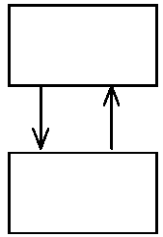
Pattern: Peer-2-Peer
Symmetric client-server model
  Clients request services from servers
  Servers can inform clients of certain events
  Peers may act as clients or servers or both
  May change roles dynamically
Client and sever typically multithreaded
Services can be implicit
  e.g. through use of connecting stream
Multiple clients may need to be informed
  e.g. event-bus
Examples:
  Multi-user applications (e.g. drawing board)
  P2P file sharing

Slide 40
Pattern: Event-Bus

Slide 41
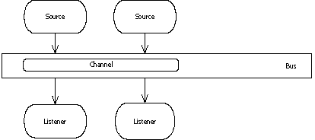
Pattern: Event-Bus
Event sources publish messages to particular channels on an event bus
Event listeners subscribe to particular channels
Listeners are notified of message availability
Message generation and notification are asynchronous
Channels can be implicit
  e.g. using event
  patterns

Slide 42
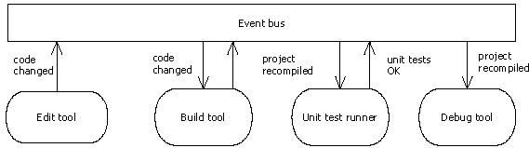
Pattern: Event-Bus
Examples:
  Process monitoring
  Trading systems
  Software development environment

Slide 43
Pattern: Event-Bus
Characteristics:
  New publishers, subscribers and connections can be added easily, possibly dynamically
  Delivery issues are important
    Distribution, ordering, guaranteed delivery, timeliness, scalability
  Implicit communication means little overall insight
Variations:
  Bus can provide event transformation services
  Bus can provide ‘coordination’ to script specific tasks

Slide 44
Pattern: Blackboard

Slide 45
Pattern: Blackboard
Useful for problems for which no deterministic solution strategies are known
  Several specialized subsystems assemble their knowledge to build a possibly partial or approximate solution
  Example: speech recognition, submarine detection, inference of 3D molecule structure
All components have access to a shared data store (the blackboard)
Components produce new data objects that are added to the blackboard
Components look for particular kinds of data on the blackboard
  Find these by pattern matching

Slide 46
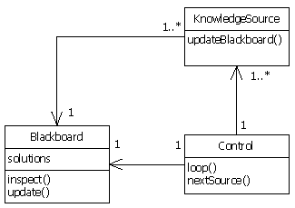
Pattern: Blackboard
Processes have to agree on the structure of the shared data space
Adding new applications is easy
Extending the structure of the data space is easy
Modifying the structure of the data space is hard
Possible need for synchronization, access control

Slide 47

This presentation is for informational purposes only. MICROSOFT MAKES NO WARRANTIES, EXPRESS OR IMPLIED, IN THIS SUMMARY. © 2001 Microsoft Corporation. All rights reserved.

